Slide 1
Complex Variable, Laplace & Z- transformation
Lecture 08

Slide 2
This Lecture Covers-
This lecture focuses on some application problem where actually Laplace transformation have an important course of action.

Slide 3
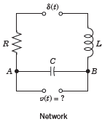
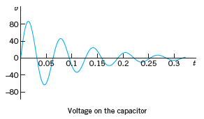
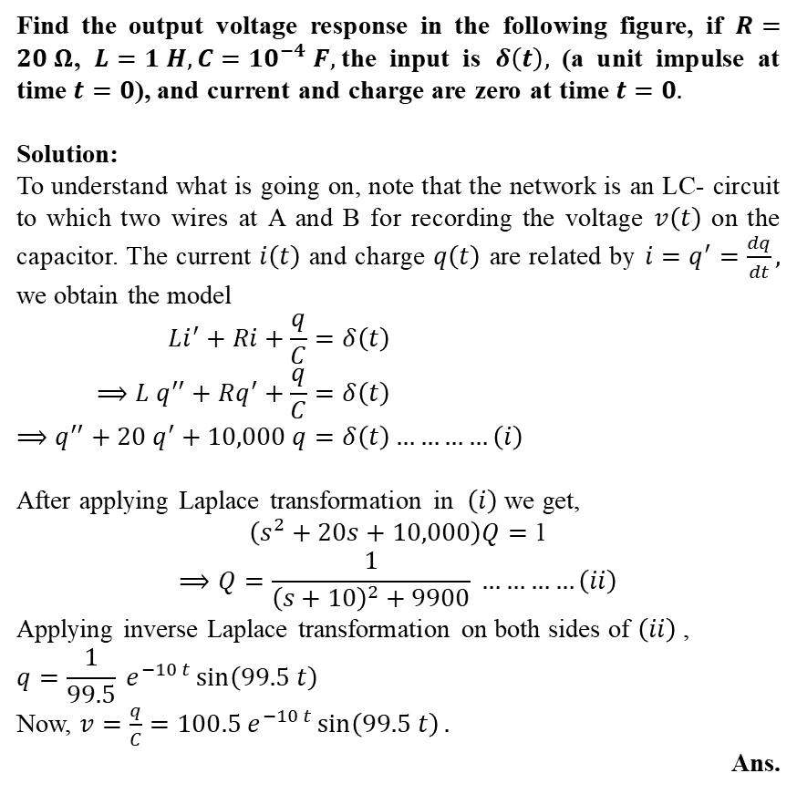
Example of some Application problems
Find the output voltage response in the following figure, if $R=20 Ω$, $L=1 H, C={10}^{−4} F,$the input is $δ\left(t\right),$ (a unit impulse at time $t=0$), and current and charge are zero at time $t=0.$
Solution:
To understand what is going on, note that the network is an LC- circuit to which two wires at A and B for recording the voltage $v\left(t\right)$ on the capacitor. The current $i\left(t\right)$ and charge $q\left(t\right)$ are related by $i=q^{′}=\frac{dq}{dt},$ we obtain the model
$$Li^{′}+Ri+\frac{q}{C}=δ\left(t\right) \\ ⟹L q^{′′}+Rq^{′}+\frac{q}{C}=δ\left(t\right) \\ ⟹q^{′′}+20 q^{′}+10,000 q=δ\left(t\right)…………\left(i\right)$$
After applying Laplace transformation in $\left(i\right)$ we get,
$\left(s^{2}+20s+10,000\right)Q=$ 1 $$⟹Q=\frac{1}{{\left(s+10\right)}^{2}+9900} …………\left(ii\right)$$
Applying inverse Laplace transformation on both sides of $\left(ii\right)$ ,
$$q=\frac{1}{99.5} e^{−10 t}\sin\left(99.5 t\right)$$
Now, $v=\frac{q}{C}=100.5 e^{−10 t}\sin\left(99.5 t\right).$
Ans.

Slide 4
Learning Outcomes
After finishing this lecture students can easily understand the influence of Laplace transformation on some application problem.

